Slide 1
KVStore Roadmap (1)
Hao Liu
Oct 21,2016

Slide 2
Source structure and process
Functional module | Source code | Process
NVM persistent memory area reserve | nvmmap.c | 1. Rely on 4.2+ kernel version; 2. Modify the grub file, reserve a fixed-size memory area, this area is considered as PM by kernel; 3. Map the KVStore address space to reserved area and can read/write the memory content successfully.
Cuckoo hash table in DRAM | cuckoo.c cuckoo.h | 1. Complete the related data structure definition; 2. Complete 3 functions of 7.
City hash function | city.c city.h | 1. Reused the cityhash source code by google; 2. Used a test case to check the correctness of the source code.
System head files | kv.h common.h | 1. Define some global variables in KVStore, and will be extended during the following development;

Slide 3
Source structure and process
Functional module | Source code | Process
Some basic functions | util.c util.h | 1. Define some macros and fundamental functions, such as memcpy.
System format in NVM | super.c | 1. Define the structure of superblock, next will fill the format function.

Slide 4
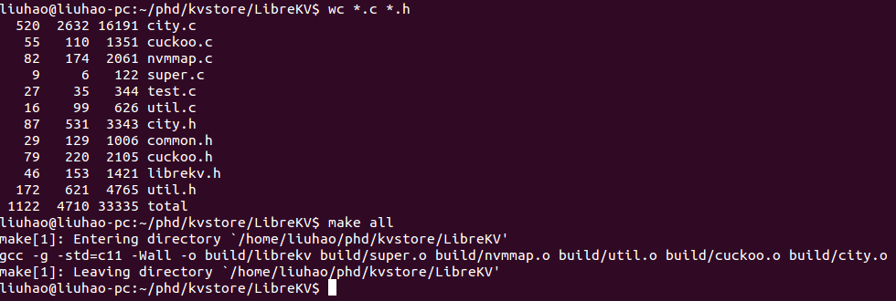
Source status
1. Compilable
2. 1122 LoC

Slide 5
Plan of next week
1. Complete cuckoo hash table and functional test
2. Linear hash table(basic functions, simple case test)

Slide 6
Open issues
1. Format in NVM may be a tough task;
2. Functional test after each small module then
continue;
3. Good programming habits, target to be
professional;
4. New idea needs to be inspired during the
development.

Slide 7
Thanks!

